Slide 1
EN.601.414/614 Computer Networks Video Streaming and Cloud Applications
Xin Jin
Spring 2018 (TTh 12:00-1:15pm in Shaffer 301)
https://github.com/xinjin/course-net
Notes:
Slides adapted from similar courses at Princeton, Stanford, UC Berkeley, University of Michigan, etc.

Slide 2
Agenda
Video streaming
Cloud applications

Slide 3
Recap: Web components
Infrastructure:
Clients
Servers (DNS, CDN, Datacenters)
Content:
URL: naming content
HTML: formatting content
Protocol for exchanging information: HTTP

Slide 4
Recap: HTTP
Client-server architecture
Server is “always on” and “well known”
Clients initiate contact to server
Synchronous request/reply protocol
Runs over TCP, Port 80
Stateless
ASCII format
Before HTTP/2

Slide 5
Recap: CDN
Caching and replication as a service
Large-scale distributed storage infrastructure (usually) administered by one entity
e.g., Akamai has servers in 20,000+ locations
Combination of caching and replication
Pull: Direct result of clients’requests (caching)
Push: Expectation of high access rate (replication)
Can do some processing to handle dynamic webpage content
Notes:
Transcoding = change compression rate per user’s bandwidth

Slide 6
Recap: DNS
Resolve names to addresses
Uniqueness: no naming conflicts
Scalable: many names and frequent updates
Distributed, autonomous administration
Ability to update my own (machines’) names
Don’t have to track everybody’s updates
Highly available
Lookups are fast
Level of indirection

Slide 7
Putting it all together
Server
User
HTTP GET

Slide 8
Putting it all together
<html>
<body>
... …
</body>
</html>
Server
User
HTTP Response

Slide 9
Putting it all together
CDN Server - 1
<html>
<body>
<img />
</body>
</html>
Server
User
HTTP GET
CDN Server - 2
DNS Server

Slide 10
Putting it all together
CDN Server - 1
<html>
<body>
<img />
</body>
</html>
Server
User
HTTP Response
CDN Server - 2
DNS Server

Slide 11
How is video different?
Often too large to send in one GET
Doesn’t even make sense even if its possible
Users may skip forward! ⇒ save bandwidth wastage
Users connection quality may change (e.g., switching from WiFi to LTE) ⇒ lower resolution to save bandwidth
Our focus is on stored video (i.e., not live)

Slide 12
Why video is important?
Dominates the Internet traffic landscape
About every 2 of 3 bytes!
Residential ISP traffic share of video content providers
Netflix: 37%
YouTube: 16%
Overall: ~70%

Slide 13
The video medium
Video is a sequence of images/frames displayed at a constant rate (moving pictures)
Digital image is an array of pixels, each pixel represented by bits
Examples:
Single frame image encoding: 1024x1024 pixels, 24 bits/pixel ⇒ 3 MB/image
Movies: 24 frames/sec ⇒ 72 MB/sec
TV: 30 frames/sec ⇒ 90 MB/sec

Slide 14
The video medium (cont’d)
Compression is key
Lots of algorithms to compress
The same video can be (and typically is) compressed to multiple quality levels
E.g., 480p, 720p, 1080p, 4K
Why multiple resolutions?
Adapt to conditions

Slide 15
How do we serve video?
It’s in the name!
Video streaming

Slide 16
HTTP streaming
Video is stored at an HTTP server with a URL
Clients send a GET request for the URL
Server sends the video file as a stream
Client first buffers for a while. Why?
To minimize interruptions later
Once the buffer reaches a threshold
The video plays in the foreground
More frames are downloaded in the background

Slide 17


HTTP streaming
Cumulative data
2. video
sent
video
recorded (e.g., 30 frames/sec)
3. video received,
played out at client
(30 frames/sec)
network delay
(fixed in this example)
time
streaming: at this time, client
playing out early part of video,
while server still sending later
part of video

Slide 18
Challenges
Absorb network delay variations
Handle user interactions
Jump forward, fast-forward, rewind, pause
Handle packet loss, retransmission etc.

Slide 19
HTTP streaming: Revisited
constant bit
rate video
transmission
client video
reception
constant bit
rate video
playout at client
Cumulative data
variable
network
delay
buffered
video
client playout
delay
time
Client-side buffering and playout delay: compensate for network-added delay, delay jitter

Slide 20
Issues with HTTP streaming
Same bitrate for all clients
Clients can have very different network conditions
Clients network conditions can change over time
Cannot dynamically adapt to conditions

Slide 21
DASH : Dynamic Adaptive Streaming over HTTP
Keep multiple resolutions of the same video
Stored in a manifest file in the HTTP server
Client asks for the manifest file first to learn about the options
Asks for chunks at a time and measures available bandwidth while they are downloaded
Low bandwidth ⇒ switch to lower bitrate
High bandwidth ⇒ switch to higher bitrate

Slide 22
Who’s serving Web services?
Server
User
HTTP GET

Slide 23
Who’s serving Web services?
<html>
<body>
... …
</body>
</html>
Server
User
HTTP Response

Slide 24
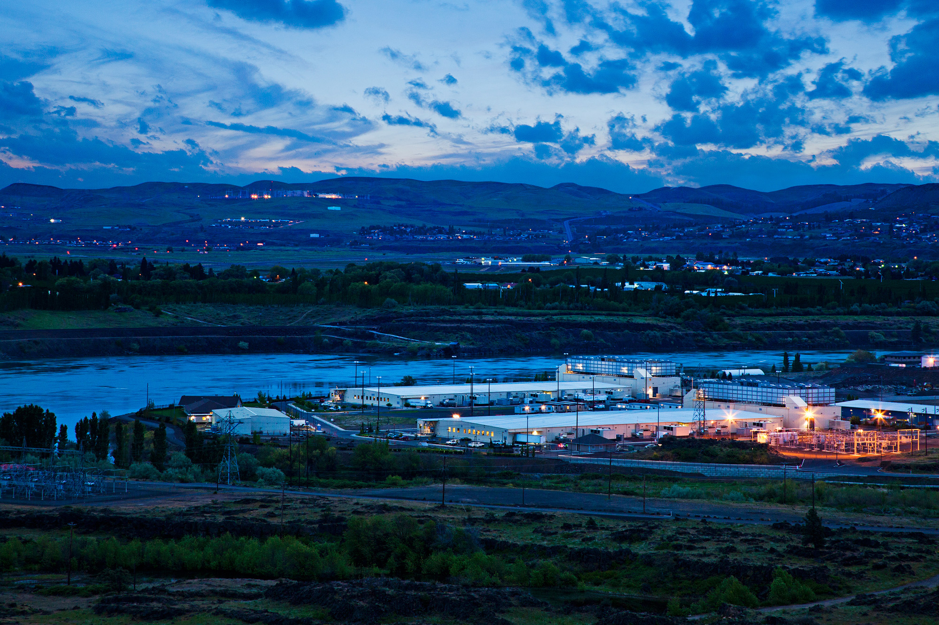
Who’s serving Web services? Datacenters
Source: Google

Slide 25
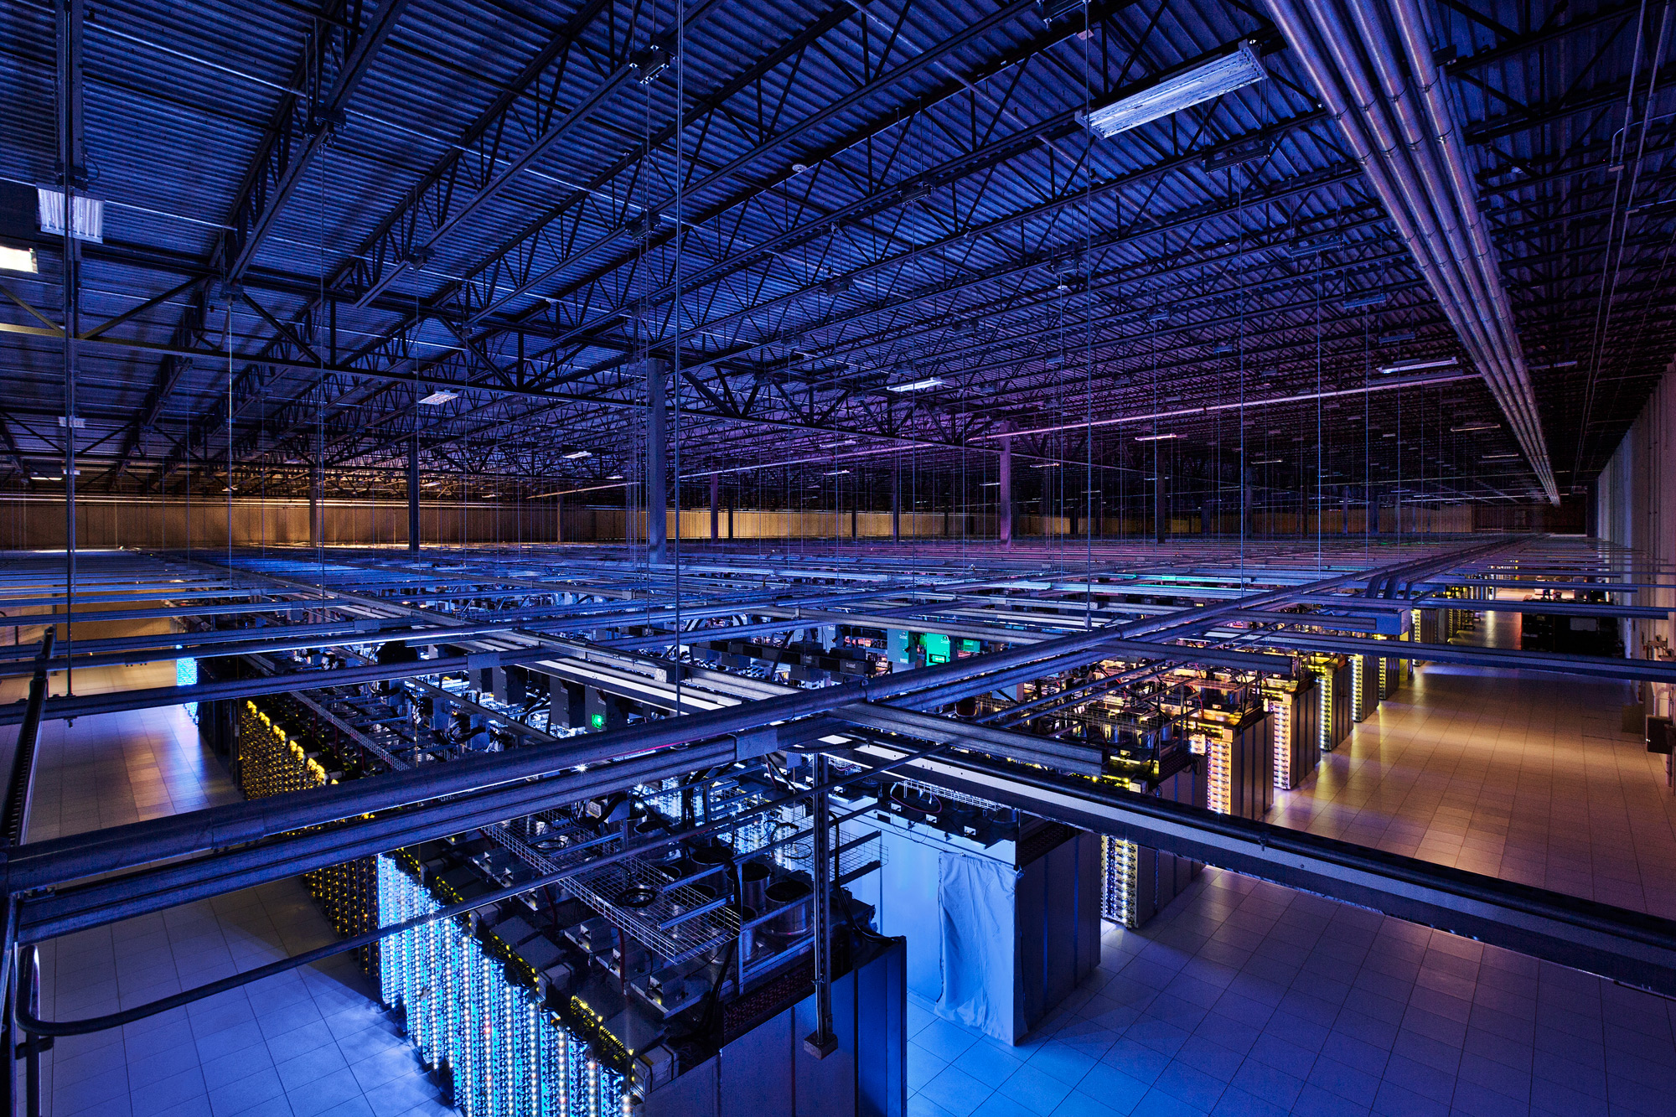
Who’s serving Web services? Datacenters
Source: Google

Slide 26

Who’s serving Web services? Datacenters
Source: Facebook

Slide 27
Datacenter networks
Tens to hundreds of thousands of hosts, often closely coupled, in close proximity:
E-commerce (e.g., Amazon)
Content servers (e.g., NetFlix, YouTube, Apple, Microsoft)
Search engines, data mining (e.g., Google)
Social networks (e.g., Facebook, Twitter, Instagram)
Challenges:
Multiple applications, each serving massive numbers of clients

Slide 28
How big exactly?
1M servers/site [Microsoft/Amazon/Google]
> $1B to build one site [Facebook]
>$20M/month/site operational costs [MS’09]
Data center hardware spending will grow to $177 billion in 2017. [Gartner report]
But only O(10-100) sites

Slide 29
Datacenter networks
Aggregation
ToR Switch
Server

Slide 30
Datacenter networks (Cont.)
Core
Aggregation
Rack

Slide 31
Challenges
Not enough bandwidth
Oversubscription: Less bandwidth in the ToR-Agg links than all the servers bandwidth in the rack
Oversubscription ratio: Ratio between bandwidth underneath and bandwidth above
Not enough paths between server pairs
Load balancing issues
Failure recovery issues

Slide 32
Modern datacenter networks: More bandwidth, more paths
Core
Aggregation
Rack

Slide 33

Let’s take a Web service
Johns Hopkins University

Slide 34
Who’s serving Web services?
Core
Aggregation
Rack

Slide 35

What happens inside?
Johns Hopkins University
Top-level Aggregator
Mid-level Aggregators
Workers

Slide 36
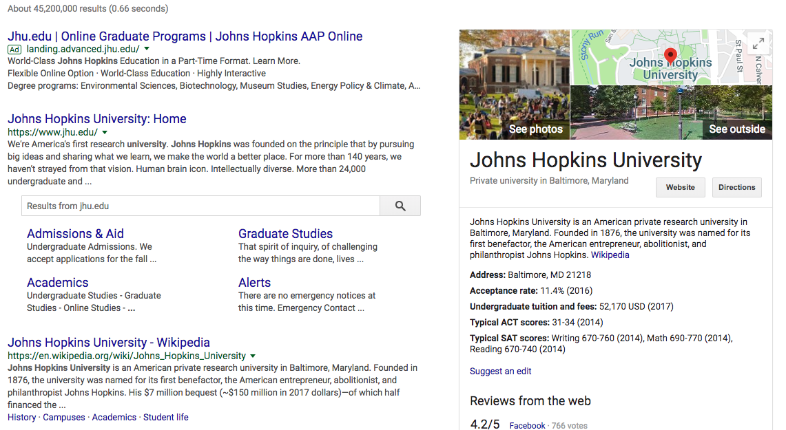
Partition-Aggregate traffic
Johns Hopkins University
Top-level Aggregator
Mid-level Aggregators
Workers

Slide 37
Partition-Aggregate traffic
Core
North-South Traffic
Aggregation
Rack
East-West Traffic

Slide 38
End-to-end response time
Less than 200 milliseconds between receiving user query in the browser and displaying the results
RTT = O(10) to 100 milliseconds
What remains?
Next time, when the page is not loading fast enough, think about the poor servers working for you ☺

Slide 39
Summary
Video streaming
Too large to send as a whole, so stream it
Dynamically adapt to the network and users
Cloud applications
Forms the backend of modern web services
Where all the processing happens
Next lecture
Read 3.1 to 3.5 of K&R

Slide 40
Thanks! Q&A

